Slide 1

Effect of Covid 19 Pandemic on Internet Usage and Education in Turkey
Mehmet Sait Altıntaş
17030411048

Slide 2

You will see the simplified and visualizations of the data sets we found on the change and transformation of the coronavirus, which affects the whole world, in our country.
Respectively,
Turkey Student Population
Turkey unemployment data
Internet usage by Regions in Turkey
- Internet usage in Turkey by years
- Internet Usage by Occupational Groups
- Reasons for internet use.
We will examine whether there is a connection and change between Covid-19 .

Slide 3
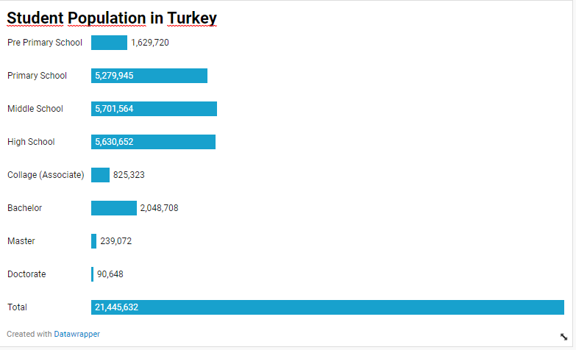
Turkey Student Population
Turkey is a country with a large young population, naturally we have a large number of students.

Slide 4
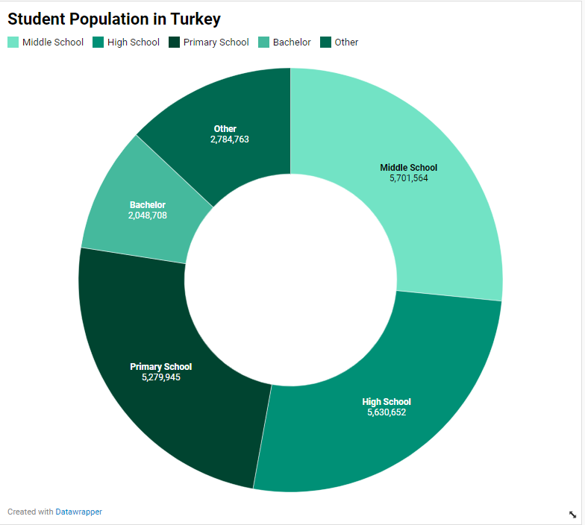
Turkey Student Population
At the same time, a large part of this student population consists of people between the ages of 5-18 and living dependent on their families.
Naturally, these students do not have a chance or opportunity to make decisions independently of their families or to access the internet.

Slide 5
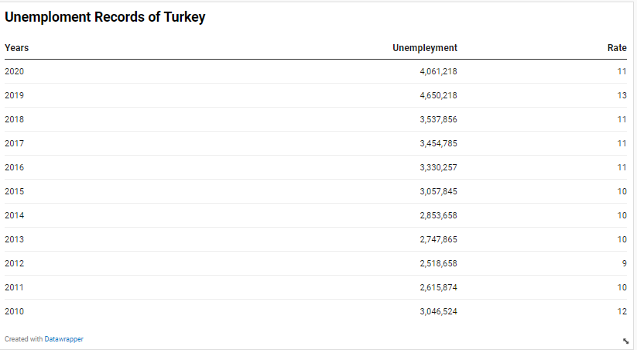
Turkey unemployment data
Unemployment is a big problem for countries, it is known that it has become more difficult to find a job during the Pandemic.
At the same time, loss of income is a situation that should have an impact on technology and internet usage, which we will look at in the following sections.

Slide 6
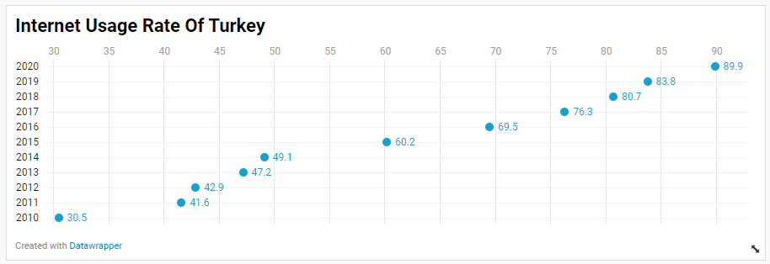
Internet usage in Turkey by years
As can be seen, due to the increasing needs, almost 90% of the society has access to the internet in some way, with a great increase over the years.
Of course, this is not only home internet, but also users who use mobile phone and wifi services are included in these numbers.

Slide 7
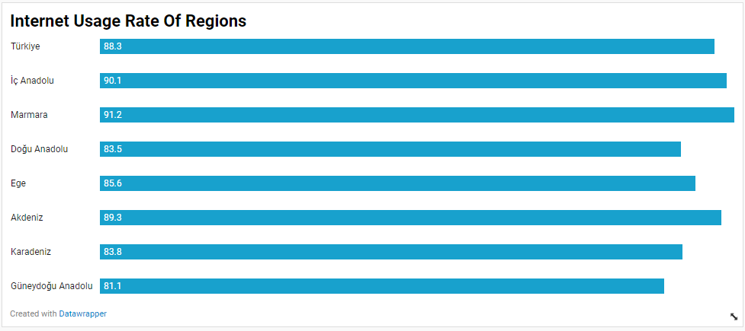
Internet usage by Regions in Turkey
When we examine Turkey's geographical regions, even if there is not a big difference, there is a 10% difference between the region with the highest usage rate and the lowest region.
It can be thought that internet use is directly related to occupation, lifestyle and income level.

Slide 8
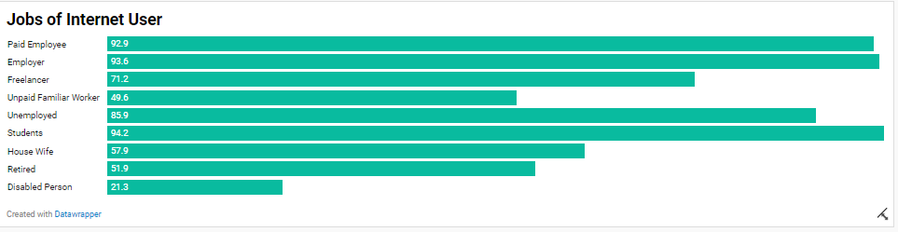
Internet Usage by Occupational Groups
As can be seen, 5 out of every 100 students in Turkey do not have access to the Internet.
At the same time, unemployed people use the Internet 5% less than a currently salaried employee, and Internet use increases in proportion to income growth.

Slide 9
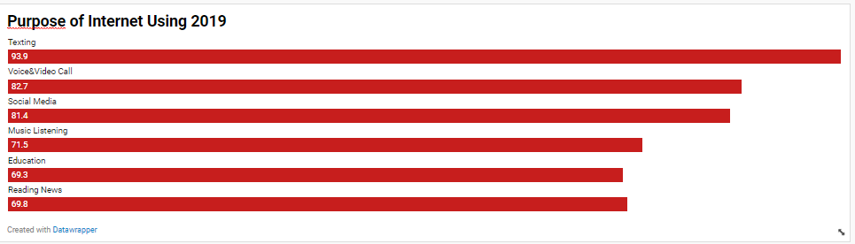
Reasons for internet use in 2019
As you can see, internet usage in 2019 is a service that meets the needs of daily life.
The population using it for education, on the other hand, lags behind newspaper readers, with a population of 69.3% doing research for lecture videos and homework.

Slide 10
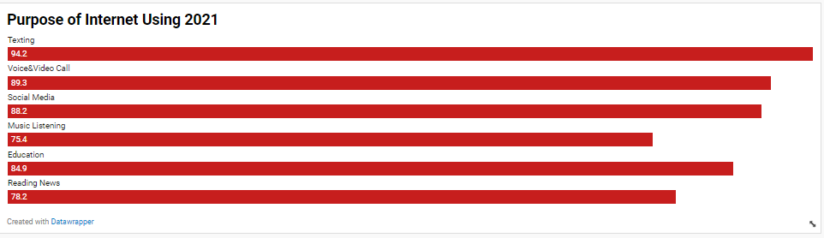
Reasons for internet use in 2021
But when we come to 2021, Education has switched to the internet at a rate of 84.9% and a large part of it is online courses and distance education platforms.
In addition, the use of social media and video calls as well as the internet as a news center has increased.

Slide 11
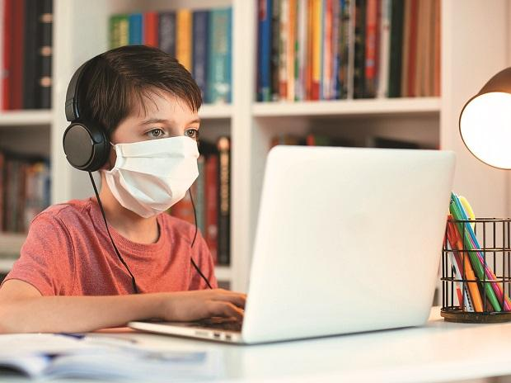
Result
-Covid 19 has increased the use of the Internet.
-Even though most of the students have access to the internet, there is still a group of students who are victims.
-Covid 19 has increased the use of social media.
-Pandemic has increased video calls and meetings.
-Income level can be associated with internet use.

Slide 12
Thanks For Listening

